Slide 1
NIEM 302
Build & Validate an IEPD
Presenter Name
Organization
Date
TRAINING

Slide 2
Course Objectives
Welcome to the NIEM 302: Build and Validate an IEPD course.
This course will instruct participants on how to map their information exchanges to NIEM and develop IEPD artifacts using some of the available NIEM tools.
DURATION
2 Hours
PREREQUISITES
NIEM 300 (IEPD Discovery & Development)
NIEM 301 (NIEM Advanced Technical Concepts)
In addition to the above, a strong background in XML and data modeling is required.
By the end of this course, you will be able to:
Create a mapping document and map you exchange data elements to the NIEM data model
Generate XML Schemas and other XML documents using NIEM tools
Validate XML Schemas to ensure NIEM Conformance

Slide 3
Course Agenda
Concept Refresh
Mapping Document
Mapping Process
Map & Model
Create XML Schemas & Artifacts
Validate XML Schemas
Build & Validate
Conclusion

Slide 4
Concept Refresh
Course Progress
0% complete

Slide 5
Module 1: Concept Refresh
Welcome to Module 1: Concept Refresh
This module will provide a refresher of basic NIEM concepts covered in previous courses.
At the end of this module, you’ll be able to:
Define an exchange content model
List the IEPD XML schemas and other NIEM XML artifacts

Slide 6
Concept Refresh
Exchange Content Models:
Are graphical representations of elements for an information exchange, as well as their associated relationships
Consist of objects, elements, associations, and possibly cardinality
IEPD XML Schemas:
IEPDs use five basic schema types to define an information exchange. They include exchange, extension, subset, reference, and constraint schema.
Exchange Schema: Define the root element of the message, as well as the overall structure of the message
Extension Schema: Define the data types and elements that are not contained within NIEM but are needed for an information exchange
Subset Schema: Contain a subset of elements and types from the NIEM reference schemas that will be used within an exchange
Constraint Schema: Restricts the values and cardinality of data types and elements within an exchange
Reference Schema: Serve as the authoritative definition schema for the NIEM namespace

Slide 7
Concept Refresh
IEPD XML Artifacts
IEPDs include additional XML artifacts that aid in the understanding and representation of an information exchange
XML Instances are used within IEPDs to show an example of an XML document that validates against the schemas defined for the exchange
Wantlists are XML documents that specify the elements and types from NIEM that will be used in an exchange
Code lists are reference lists used to constrain values for a give element to a predetermined list
Stylesheets provide formatting or transformation for the data used within an exchange

Slide 8
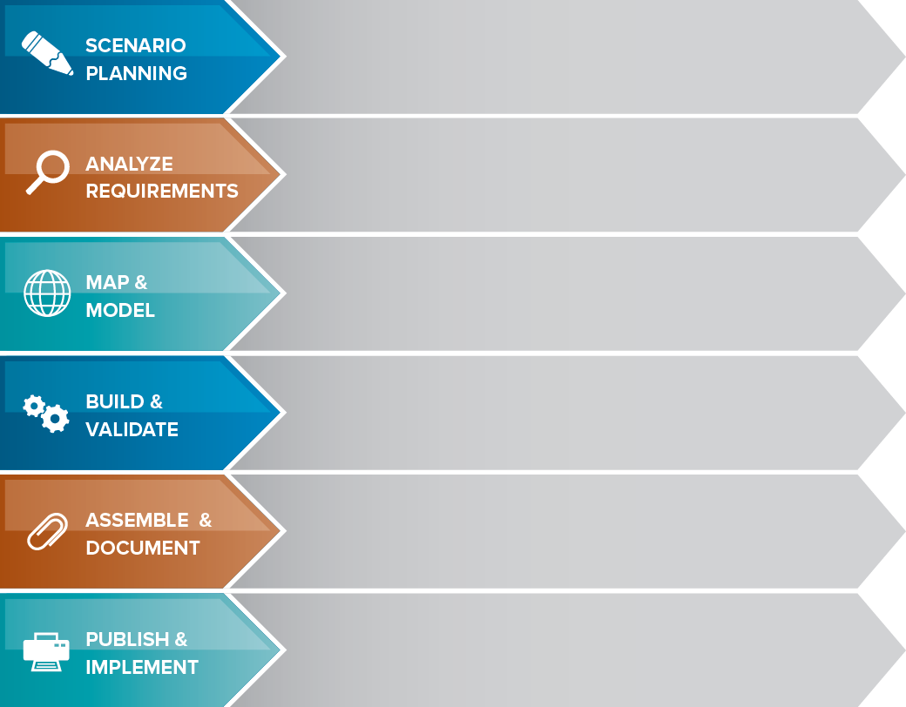
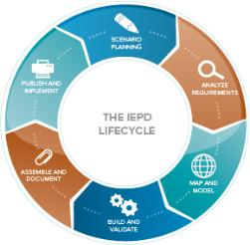
The IEPD lifecycle
Review background, assess resource impact, understand business context, and identify information exchange business scenarios
Selected information exchange scenario is further elaborated to understand and document the business context and data requirements
Create an Exchange Content Model based on information exchange requirements. The Exchange Content Model is then mapped to NIEM.
Create a set of exchange-specific NIEM conformant XML schemas that implement the Exchange Content Model created for the exchange
Prepare and package all related files for the IEPD into a single self‐contained, self-documented, portable archive file
Implement the IEPD into production as well as publish the IEPD for search, discovery, and reuse.
8

Slide 9
The IEPD Artifacts
Business Processes Diagrams
Use Case Diagrams
Sequence Diagrams
IEPDs contain both required and recommended artifacts
Required:
Bold and Blue
Recommended:
Plain
Note:
Best practices for most organizations include many of the artifacts listed here.
Please review Model Package Description (MPD) specifications for more information.
Business Rules
Business Requirements
Exchange Content Model
Mapping Document
Subset Schema
Exchange Schema
Wantlist
Constraint Schema
Extension Schema
Reference Schema
XML Stylesheets
Master Document
Catalog
Change Log
Sample XML Instances
No required artifacts. Publish the IEPD to a repository and implement the exchange
9

Slide 10
Maintain an Exchange
After the project is complete, the IEPD needs to be maintained throughout its existence.
To sustain an IEPD:
 | Ensure that any changes to an information exchange are correctly reflected within the IEPD.
 | A governance process, if applicable, should be established to actively manage the changes identified for an IEPD
 | Over time, the technical architecture of the information exchange is likely to change; update the IEPD to reflect these changes.
 | Once changes are made to the IEPD, publish a new version of the IEPD within online repositories.
Choosing to NOT maintain an IEPD inhibits re-use within and outside the organization.
!

Slide 11
Module 1 - Knowledge Check 1
Which of the following is true for Exchange Content Models?
A. Contain a subset of elements and types from NIEM that will be used within an exchange
B. Provide formatting or transformation for the data used within an exchange
C. Restrict the values and cardinality of data types and elements within an exchange
D. Consist of objects, elements, associations (with possible cardinality)

Slide 12
Module 1 - Knowledge Check 2
Wantlists_________________________?
A. Are used as an example message that validates against previously defined IEPD schemas
B. Are XML documents that specify the elements and types that are needed for NIEM and will be used in an exchange
C. Are reference lists used to constrain values for a given element to a predetermined list
D. Provide formatting or transformation for the data used within the exchange

Slide 13
Module 1 - summary
You have completed Module 1: Concept Refresh.
You should now be able to:
Define an exchange content model
List the IEPD XML schemas and other NIEM XML artifacts

Slide 14
Map & Model
Course Progress
20% complete

Slide 15
2.1 Mapping Document
Concept Refresh
Mapping Document
Mapping Process
Map & Model
Create XML Schemas & Artifacts
Validate XML
Schemas
Build & Validate
Conclusion

Slide 16
Module 2: Map to NIEM
Welcome to Module 2: Map to NIEM
This module will be presented in two sections:
2.1: Mapping exchange data to NIEM
2.2: The Mapping Process

Slide 17
Module 2.1: Mapping Document
At the end of this module, you’ll be able to:
Explain the purpose of a mapping document
Describe the purpose and components of source data columns, NIEM data columns, and mapping columns

Slide 18
Mapping Documents in IEPD Development
Exchange Content Model
Mapping Document
XML Schemas
Objects in the exchange content model are represented in the Mapping Document
Associations and cardinality are not typically represented in the Mapping Document
Do not have to explicitly use data objects from the NIEM data dictionary
Used in the process of mapping the elements of an information exchange to NIEM
Identifies all objects from the exchange content model to determine where NIEM reuse can occur or where NIEM requires extension
After completing a Mapping Document, elements and types can be identified for inclusion in NIEM subset schemas or extension schemas
If a “container” data object (complex XML element) in NIEM is reused, the object will not be able to hold character data

Slide 19
What is a Mapping Document?
A document to identify how exchange data aligns to, or “maps,” and reuses NIEM data objects
Referred to as a Component Mapping Template (CMT), Component Mapping Tool, Mapping spreadsheet, etc.
Demonstrates how data objects within an exchange map to data objects in NIEM by recording the degree of similarity
Aids the identification process of objects that are not currently within NIEM and are candidates for inclusion in an extension schema
This document helps communicate the level of reuse in NIEM to business users/owners
The mapping document is an effective tool for documenting how the NIEM data model was reused. A template is available for use on NIEM.gov.

Slide 20
Mapping Document Example
Below is an example of the Component Mapping Template which can be used to document IEPD mapping.
Source Container Type
Source Element
Source Date Type
Source Element Definition
Mapping
NIEM Element
NIEM Element Path
NIEM Type
NIEM Element Definition
A
C
B
Source Data Columns
Mapping Column
NIEM Data Columns

Slide 21
Source Data Columns
These columns represent the exchange data as they are currently represented. They will be completed with information from the exchange content model, the “source data.”
A
Source Container Type | Source Element | Source Data Type | Source Element Definition
The data source high-level object, class, or context of a set of data elements (e.g., person, vehicle, arrest) | The source element is a specific data element that is associated with the Source Container Type | Data type of the source element | The definition of the source element being mapped
Example
Person | DateofBirth | Date | Date of birth of a person

Slide 22
NIEM Data Columns
In a completed Mapping Document, the ‘NIEM Data Columns’ contain information about the NIEM data element that is being reused for a given source element if an appropriate mapping exists.
B
NIEM Element | NIEM Element Path | NIEM Type | NIEM Element Definition
The name of the NIEM element the source element is mapped to | The path of the NIEM Element within the NIEM Model | The name of the type that is associated with the NIEM element | The standard definition for the NIEM element found in the element’s metadata
Example
nc:PersonBirthDate | nc:Person/ nc:PersonBirthDate | nc:DateType | A date a person was born

Slide 23
Mapping Column
In a Mapping Document, users must search the NIEM model for appropriate data elements to map to local exchange data.
If a NIEM element is found, the correlation of the source and NIEM elements is recorded here.
C
Mapping
Identifies how the source object or element maps to the NIEM object or element.
Example
Equivalent
Mapping “value” is the degree to which a source element maps to a NIEM element. Possible “values” include:
Equivalent
Partial
No Match
It is recommended to include additional notes in the mapping document to provide reasoning and context

Slide 24
2.2 Mapping Process
Concept Refresh
Mapping Document
Mapping Process
Map & Model
Create XML Schemas & Artifacts
Validate XML
Schemas
Build & Validate
Conclusion

Slide 25
Module 2.2: The Mapping Process
At the end of this module, you’ll be able to:
List the two steps in the mapping process
Correctly list the five steps for properly setting up a mapping document
Explain how to search and map NIEM elements
Define the three mapping values in the mapping column

Slide 26
Mapping Process
The process for mapping is composed of two steps:
1
Set up a Mapping Document
2
Search and Map NIEM Elements

Slide 27
Setup a Mapping Document
1
Setup a Mapping Document
The following steps can assist in the initial setup of the document:
Identify an object within the exchange content model as your starting point for entry in the document; this is the “Source Container Type” (a Source Container Type is the containing object to which elements belong)
Identify an element within that object; this is the “Source Element”
Identify the data type for the element; this is the “Source Data Type”
Provide a definition for the element; this is the “Source Element Definition”
Repeat the previous steps for each object in an “Exchange Content Model”

Slide 28
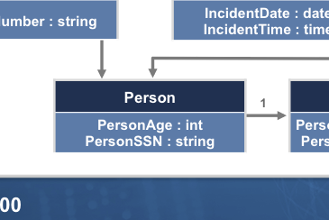
Mapping Transfer from Models
Four columns should be filled in for every element within the exchange content model
Source Container Type | Source Element | Source Data Type | Source Element Definition
Person | PersonSSN | string | A social security number
Review existing documentation to determine element definition

Slide 29
Search and Map NIEM Elements
2
Search and Map NIEM Elements
The following steps can assist in finding NIEM elements that may have the same logical definition, semantics, and structure as source elements
Using a NIEM tool, find an element from a NIEM reference schema that “maps” to the exchange data element
Try searching by name, for synonyms, conceptual meaning, or by type
Map objects that are conceptually and semantically equivalent; if the alignment is not easily understood it is better to extend
Document the information about the NIEM data object, including the type of mapping (equivalent, partial, no match), if one is found

Slide 30
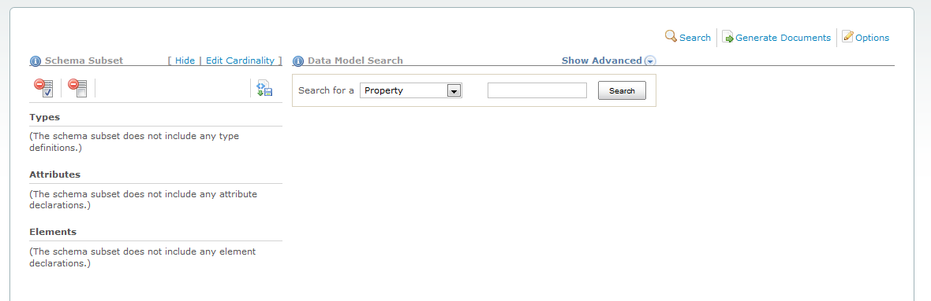
NIEM Tools Catalog: Search & Map
The Schema Subset Generation Tool is available to support the mapping process.
https://www.niem.gov/SSGT

Slide 31
Searching the Model
Searching the NIEM data model can be difficult, but these methods will help.
Search Method | Explanation | Example
Name Variations | Searching for variations of a name can often yield results | Search for Officer instead of Official to yield j:EnforcementOfficial
Conceptual Meaning | Search for words that could be in the definition of the data object | Search for Modified Charge to yield j:AmendedCharge
Synonyms | Synonyms of the data object to find exactly what you are looking for | Search for Facility instead of Building to get different results
Containers | Use a more abstract term to find containers of the data objects | Search for Person instead of Person Arrest to get the maximum number of results

Slide 32
Reuse of the NIEM Data Model
nc:PersonName
is of type
The hierarchical implications of the model must be considered when reusing NIEM elements
Elements and types are defined globally and referenced when used
Type hierarchy provides a contextual representation of the element
Attributes are assigned to some types to provide context on their use
NIEM’s hierarchal approach to modeling allows for flexibility and reuse, while still maintaining context
nc:PersonNameType
contains
nc:PersonGivenName
nc:PersonSurName
is of type
nc:PersonNameTextType
nc:ProperNameTextType
nc:TextType
niem-xsd:string

Slide 33
Mapping Values
The value of the “Mapping” column are constrained to the values below:
Semantics and structure map exactly or almost exactly. The NIEM data object’s name and definition should have exactly the same conceptual meaning as the exchange data object.
Partial Match is where you can take some things from NIEM and have to extend the rest for a given Type.
No NIEM element or type maps to the source requirement. The result is an extension to NIEM through an IEPD extension schema.
Equivalent Match
Partial Match
No Match

Slide 34
Equivalent Match
An “Equivalent Match” is when the semantics and structure of the exchange and NIEM data object align exactly or almost exactly.
If a NIEM object has similar semantics and structure to an exchange data object, it is probably an equivalent match
Even equivalent matches can be difficult to find due to complex containers and different names
A first check would be to verify that the NIEM data object’s definition and its containing objects logically align to the exchange object
Exchange Data | NIEM Data Objects
Person | nc:Person
Person Name | nc:Person/nc:PersonName
Person First Name | nc:Person/nc:PersonName/nc:PersonGivenName

Slide 35
Partial Match
A “Partial Match” is when the semantics or structure of an exchange and NIEM data objects do not exactly fit.
These are the most difficult mappings to find in the NIEM data model; it is the gray area that exists between equivalent and no match
Most partial matches can be categorized into three categories: semantic, structural, and container conflicts
Mitigations exist for each of these three categorizes that will maintain the integrity of the NIEM data model
Even with these mitigations, there are cases where an exchange object simply will not map to the NIEM data model
When mapping, be conservative in extending NIEM data objects to maintain the integrity of the NIEM data model

Slide 36
Partial Match Types
Conflict Description | Example(s) | Mitigation
Semantic: Occurs when there is a small discrepancy in definition or name | nc:Date does not align exactly with local-ns:EntryDate | Reuse the NIEM data type and create a local element
Structural: Occurs when the NIEM data object has constraints that disallow a direct mapping of the exchange data object | Data type mismatches Code lists (enumeration facets) do not have all necessary entries | Reuse the NIEM element and either create a new data type or extend a NIEM base type
Container: Occurs when an exchange data object hierarchy does not match the hierarchy of a desired NIEM data object | Data object contains (or is contained within) elements or types that do not make logical sense or align well | Reuse the NIEM element and/or type but create local elements and/or types to contain them

Slide 37
No Match
A “No Match” is when an exchange data does not map to NIEM.
Similar to some partial matches, the result is an extension to NIEM contained in an IEPD extension schema
When a “no match” occurs, a new element is created for the exchange object
A number of obvious cases will almost always have “no match”
Specific local information, such as code tables (enumeration facets)
A “new” government or private sector issue or data object that has not made it into the model
Uncommon data, such as something very specific to a particular organization
Exchange Data | Mapping Value* | NIEM Data Objects
Cargo Ship | Partial Match | nc:Vessel
Hazmat Indicator | No Match | nc:Vessel/local ns:HazmatIndicator
* The mapping value is intended to show the difference between a Partial Match and No Match

Slide 38
Module 2 – Knowledge Check 1
Which of the following is NOT a step in setting up a Mapping Document?
A. Identify an object within the Exchange Content Model as your starting point for entry in the document; this is the “Source Container Type”
B. Identify an element within that object; this is the “Source Element”
C. Identify the data type for the element; this is the “Source Data Type”
D. Try searching by name, for synonyms, conceptual meaning, or by type.
E. Provide a definition for the element; this is the “Source Element Definition”
F. Repeat the previous steps for each object in a Exchange Content Model

Slide 39
Module 2 – Knowledge Check 2
Most _______ matches can be categorized into three categories: semantic, structural, and container conflicts.
A. Equivalent
B. No
C. Partial
D. Exact

Slide 40
Module 2 - Summary
You have completed Module 2: Map to NIEM.
You should now be able to:
Explain the purpose of a mapping document
Describe the purpose and components of source data, NIEM data, and mapping columns
List the two steps in the mapping process
List the five steps for properly setting up a mapping document
Explain how to search and map NIEM elements
Define three mapping values in the mapping column

Slide 41
Build & validate
Course Progress
40% complete

Slide 42
Create xml schemas & artifacts
Concept Refresh
Mapping Document
Mapping Process
Map & Model
Create XML Schemas & Artifacts
Validate XML
Schemas
Build & Validate
Conclusion

Slide 43
Module 3: Create XML Schemas & Artifacts
Welcome to Module 3: Create XML Schemas & Artifacts
This module will be presented in nine parts:
3.1 Creating an XML Schema
3.2 Creating a Subset Schema
3.3 Creating a Constraint Schema
3.4 Creating an Extension Schema
3.5 Creating an Exchange Schema
3.6 Creating a Wantlist
3.7 Creating an XML Instance
3.8 Creating a Stylesheet
3.9 Generating a Code List

Slide 44
Module 3.1: Creating an XML Schema
At the end of this module, you’ll be able to:
Identify where an XML is used in IEPD development
Describe the two methods that can be used to create XML schemas for NIEM-conformant exchanges
List the NIEM tools that are available to assist in schema generation

Slide 45
XML Schema in IEPD Development
Exchange Content Model
Mapping Document
XML Schemas
Exchange models provide a graphical representation of the structure and data of an information exchange
Structure and data of the model will eventually be reflected in the XML schemas of the exchange
Designates what data in the exchange content model will reuse NIEM data objects
Elements and types that “equivalently” align to NIEM will appear in subset schemas
Elements and types that have “no match” in NIEM will appear in an extension schema
Data objects identified in the mapping document will appear in either the exchange, extension, or subset schemas
Associations and cardinality from the exchange content model will be reflected in XML schemas

Slide 46
Creation of XML Schemas
XML schemas that are typically created for an IEPD include subset, exchange, extension, constraint, and reference. A NIEM-conformant IEPD is required to constraint at least one schema that is either a NIEM reference schema or subset schema. XML schemas for NIEM-conformant exchanges can be created in two ways. They can either be generated through tools or manually coded.
Generation through Tools
Automatically generate schemas based on an exchange content model, mapping document, or other inputs
Code By Hand
Start with existing schemas and/or NIEM schema templates, which can be derived from NIEM reference schemas
Recommended to start with tools and modify as needed
It’s important to note that regardless of the method used to generate schema, one must follow the NIEM Naming and Design Rules (NDR) when building these schemas.

Slide 47
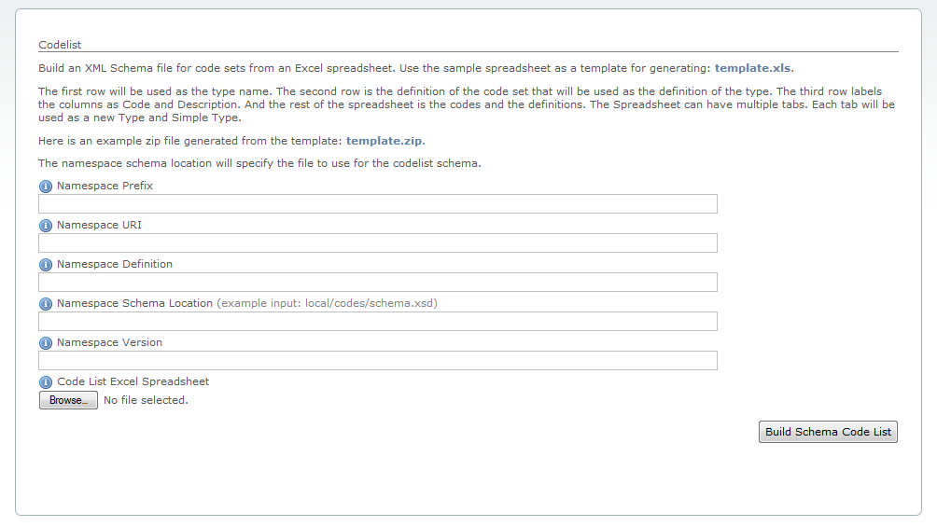
NIEM Tools Catalog: Schema Generation
The NIEM Tools catalog provides a marketplace for a number of different tools that aid in schema generation. The Code List Generator provides you with the ability to build an XML schema file for code sets from an Excel spreadsheet.
https://www.niem.gov/CLG

Slide 48
Module 3.2: Creating a Subset Schema
At the end of this module, you’ll able to:
List the characteristics of a subset schema
Explain how to use features of the subset schema generation tool (SSGT)
Describe how to upload an existing wantlist

Slide 49
Create a Subset Schema
Subset schemas are constructed by reusing the elements and types needed for the exchange from NIEM reference schemas
Subset schema:
Subset schema is a required artifact of an IEPD and should be NIEM-conformant
Subset schema should always validate against the entire reference schema
Subset schema can be generated using a number of tools from a variety of inputs (such as Wantlists and XMI files)

Slide 50
Subset Schema Generation Tool
The Subset Schema Generation Tool (SSGT) is a common starting point for schema development, because it is free, easy to use, and produces Subset Schemas for use within an exchange.
SSGT can also be used for searching and browsing the NIEM data model, as well a generating Wantlists.
Schema Subset Generation Tool
The Subset Schema Generation Tool (SSGT) is part of the NIEM Tools Catalog and can be used to generate a Subset Schema for use within an exchange
This can be completed by either mapping elements using the tool interface or uploading a wantlist

Slide 51
Using a Wantlist with the SSGT
A Wantlist is essentially an XML files that describes what an exchange “wants” from the NIEM data model. It directly aligns to the subset schema. SSGT also provides the functionality to generate a subset schema based on a Wantlist.
Using a Wantlist
Wantlists are primarily used to generate a subset schema for a particular information exchange
Elements and types that have been mapped to NIEM are included as part of the wantlist.
The types and elements that are part of the wantlist represent those elements that are going to be part of the subset schema

Slide 52
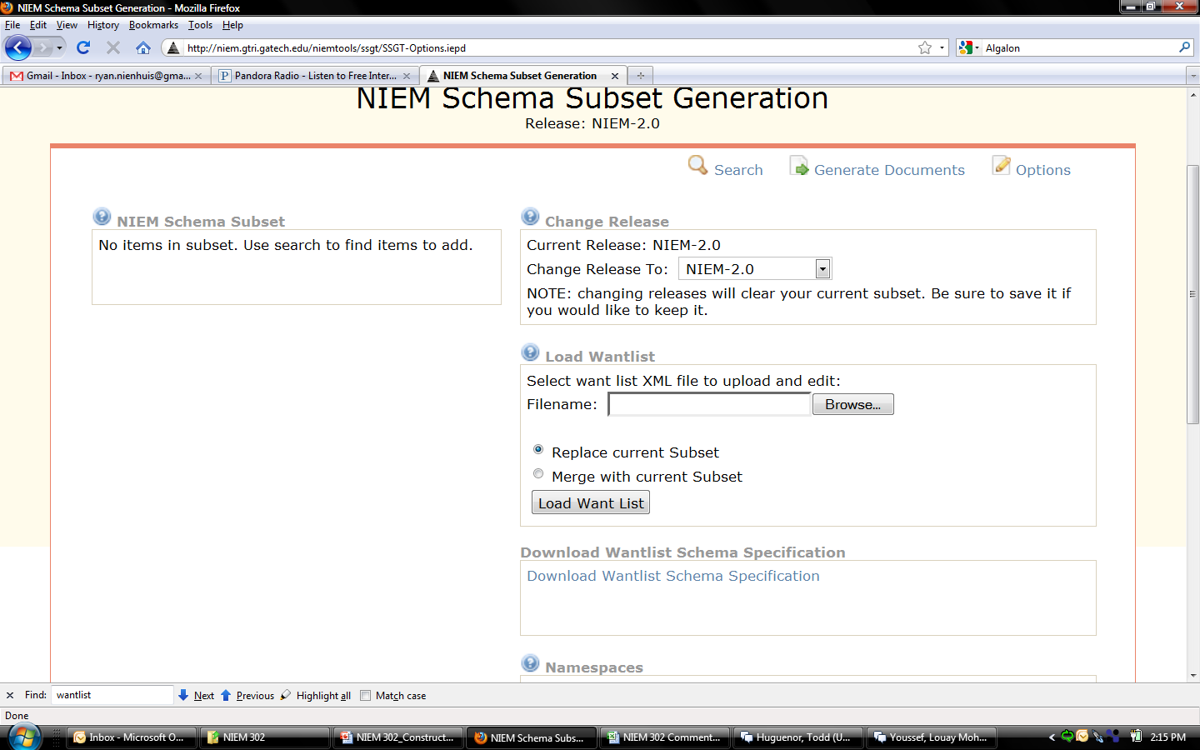
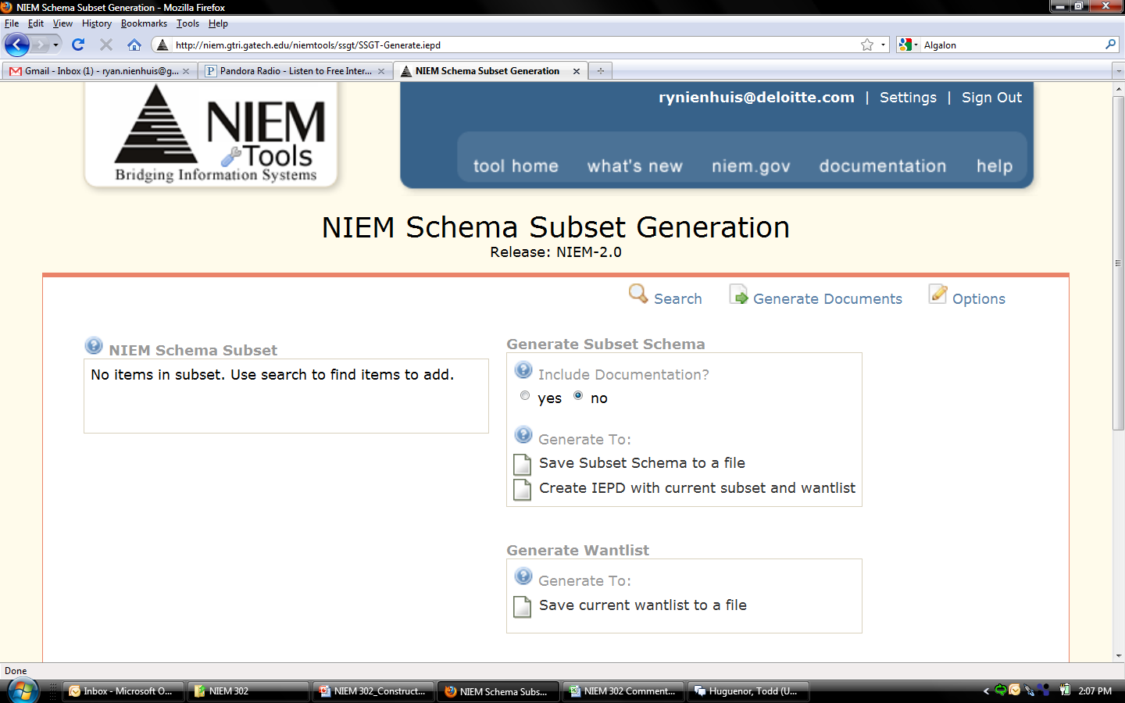
Schema Subset Generation Tool
First step:
Load Wantlist into SSGT
Second step: Generate Subset Schema

Slide 53
Module 3.3: Creating a Constraint Schema
At the end of this module, you’ll be able to:
List the characteristics of a constraint schema

Slide 54
Create a Constraint Schema
Constraint schema are used to add additional restrictions to elements and types in the exchange
Constraint Schemas:
Are not a required artifact of an IEPD and do not have to be NIEM-conformant
Are derived from Subset Schemas
Are used to reflect the business rules of the exchange
If a separate schema is developed, an additional validation path in needed to validate against the Constraint Schema

Slide 55
Module 3.4: Creating an Extension Schema
At the end of this module, you’ll be able to:
List the characteristics of an extension schema

Slide 56
Create an Extension Schema
Extension schemas define exchange specific types, elements, and attributes not available within NIEM. The Extension schema also includes reusable data components for a given exchange
Extension Schemas:
Are not a required artifact of an IEPD (it is possible for an IEPD to just have an Exchange Schema and a Subset Schema)
If the data objects in the Extension Schema will be reused, it is better to have a separate schema and local namespace defined for that schema. This is because Exchange Schema cannot be reused effectively between information exchanges because they contain the root element of the information exchange, which is unique to each individual exchange.

Slide 57
Module 3.5: Creating an Exchange Schema
At the end of this module, you’ll be able to:
List the characteristics of an exchange schema
Identify additional XML artifacts

Slide 58
Create an Exchange Schema
An Exchange schema is used to define the root (highest level) element of the exchange, as well as any other content specific to this IEPD that will not be reused by other IEPDs
Exchange Schemas:
Are required in an IEPD
Import, reuse, and arrange the data objects from other schemas in the exchange
Are unique to each exchange
That are reused from existing exchanges can provide a template for the structure and content of the new exchange schema
An IEPD may have multiple exchange schemas. This is due to the fact that multiple information exchanges may be documented through a single IEPD where each information exchange has its own exchange schema, but shares a common extension schema

Slide 59
Additional XML Artifacts
In addition to exchange, extension, subset, and constraint schemas, there are four additional XML artifacts that are recommended to include within an IEPD. These are labeled “XML Artifacts” because they are not part of the four major schemas included in an IEPD, covered previously. However, they are highly recommended. The file extensions on these “artifacts” include XML, XSD, and XSL; therefore, not all of these artifacts are XML schema (XSD).
Wantlists
Stylesheets
Instances
Code Lists
An XML file that contains the elements and types from NIEM that will be included within the Subset Schema for the exchange
A stylesheet is built using eXtensible Stylesheet Language (XSL) and is used to make an XML instance human (or browser) readable
A sample XML instance is defined as the exchange message “payload” and validates against the IEPD schemas
An XML schema of a list of allowable values for a data element within an exchange

Slide 60
Module 3.6 – creating a wantlist
At the end of this module, you’ll be able to:
Describe the two ways that wantlists can be created

Slide 61
Create a wantlist
Wantlists can be createdz in two ways:
A
Automatically generated – When using most NIEM tools, wantlists can automatically be generated and downloaded for inclusion in an IEPD.
Wantlists can be either an input or an output to the generation process.
B
Manually created – Wantlists can be created by hand and used to structure the Subset Schema generation process.
Wantlists created in either manner can also be included in the IEPD.

Slide 62
module 3.7: Creating an XML Instance
At the end of this module, you will be able to:
Understand the requirement for creating an XML Instance

Slide 63
Create an XML Instance
There are various XML editing tools that can generate XML Instances based on XML schemas
XML Instances can only be created once all schemas have been generated
XML Instances are required IEPD artifacts
XML Instance Recommendations
Schema validation tools can be used to test XML Instances against the NIEM schemas
XML Instances should be validated against both “paths” via the subset schemas and the constraint schemas (if applicable)

Slide 64
module 3.8: Creating an XML Stylesheet
At the end of this module, you’ll be able to:
Identify the characteristics of an XML Stylesheet

Slide 65
Create an XML Stylesheet
Stylesheets are commonly added to IEPDs to provide readability to the XML instance document(s) and IEPD catalog
However, no universal guidance exists for the formatting or inclusion of XML stylesheets in IEPDs
Stylesheets are not required artifacts of an IEPD
Stylesheet Recommendations
Stylesheets should be included in the IEPD so that people viewing the IEPD do not have to read through raw XML to view a sample instance document, or view the IEPD Catalog
Sample XML instances for an exchange should be linked to the stylesheet in order to view the instances in a more consistent and presentable format
The IEPD catalog should be linked to a stylesheet in order to view catalog metadata in a more consistent and presentable format. (Also, an example of a catalog stylesheet (mpd-catalog.xsl) can be found at: http://reference.niem.gov/niem/resource/mpd/catalog/1.0/example/.)

Slide 66
Module 3.9: Creating a Code List
At the end of this module, you will be able to:
Describe the two ways that codes lists can be created
Identify the characteristics of a code list

Slide 67
Create a Code List
Code Lists are a part of XML schemas that can be created in two ways:
A
Automatically generated – A spreadsheet of code list values created by the user, based on a template, can be uploaded to the Code List Generation tool to generate a NIEM-conformant representation of the code list. The spreadsheet template used by the Code List Generation Tool can be found in the NIEM.gov Tools Catalog.
B
Manually created – Code Lists are created by using previously developed XML schemas and inserting XML code through the use of enumeration facets

Slide 68
Module 3 – Knowledge Check 1
True or False: Constraint Schemas are not a required artifact of an IEPD and do not have to be NIEM conformant
A. True
B. False

Slide 69
Module 3 - summary
You have completed Module 3: Create XML Schemas and Artifacts.
You should now be able to:
Identify how XML Schema relates to Exchange Content Model and Mapping Document
Describe how to create XML Schemas for NIEM-conformant exchanges
Define a Subset Schema
Explain how to use a wantlist to create a Subset Schema
Define Exchange Schema, Extension Schema, and Constraint Schema
Identify additional XML Artifacts

Slide 70
Validate XMl schemas
Course Progress
60% complete

Slide 71
Validate xml schemas
Concept Refresh
Mapping Document
Mapping Process
Map & Model
Create XML Schemas & Artifacts
Validate XML
Schemas
Build & Validate
Conclusion

Slide 72
Module 4: Validate XML Schemas
Welcome to Module 4: Validate XML Schemas
At the end of this module, you’ll be able to:
Define conformance
Recognize the importance of validation of XML Instances
Identify the characteristics of the conformance validation tool
Explain how to resolve validation errors

Slide 73
Conformance of XML Schema
Conformance is the adherence to predefined rules and guidelines as defined in the NIEM Naming and Design Rules (NDR) and Model Package Description (MPD) Specification.
NIEM conformance promotes increased levels of interoperability and reuse within exchanges
NIEM conformance adheres to W3C specifications for valid, well-formed XML Schema
NIEM conformance applies mainly to reference, exchange and extension schemas, as well as XML instances as defined by the NDR
The NDR provides other general conformance guidelines and principles
XML Schema need to be checked for conformance both by hand and through the use of tools since currently no tool exists that automates all of the NDR rules

Slide 74
Validation of XML Instances
Validation promotes conformance through the process of testing XML to create well-formed and NIEM-conformant schemas.
XML Instances must validate against the XML schemas used within an exchange
Each XML element must validate against the schema definition of that element
XML Instances MAY be validated through multiple schema validation passes, using multiple schemas for a single namespace
Schemas must be validated in order to be conformant. You can leverage NIEM tools, such as the SSGT, to make the validation process easier.

Slide 75
Conformance Validation Tool
Conformance Validation Tool
The NIEM Conformance Tool is an option available for you to validate schema. This tool allows you to upload an IEPD, a set of schemas in a zip file, or an individual schema.
Uses Schematron language to directly check against the latest version of the NIEM NDR
Provides a summary report that contains a list of the NDR rules that were checked with those that passed and those that failed
Indicates which rules have to be manually checked
Important notes about the tool
Does not check all NDR rules as some rules are subject to interpretation
Available for evaluation and feedback purposes only; is not the measure for NIEM conformance
Intended to assist developers by automatically identifying potential locations of non-conformance within IEPD artifacts (e.g., schemas, catalog, xml) using the latest published NIEM specifications
Source: NIEM Tools Website

Slide 76
Resolve Validation Errors
The Conformance Validation Tool will output a summary report that lists the location of schema failures by line number and by XML object name
1
Resolve each validation error by reviewing the location of the error within the schema and the NDR rule(s) that was broken for that error
Make modifications to the appropriate schema to address each validation error
Run each schema through the Conformance Validation Tool to check for NIEM conformance
Repeat the error resolution process until all conformance errors have been resolved
2
3
Please contact the NIEM Help Desk at NIEM.gov/contactus if you are unable to resolve conformance errors or need additional assistance

Slide 77
Manual Review Process
A manual review of each schema should be performed to address the NDR rules not checked within the Conformance Validation Tool
1
Review the summary report from the Conformance Validation Tool to identify the NDR rules not checked through the tool
Analyze each schema for adherence to each of the NDR rules that were not checked within the Conformance Validation Tool
Make the appropriate changes to the schema(s) to resolve each issue per mistakes made in the manual review
After Steps 1-3, it is recommended that the schemas be validated again in the Conformance Validation Tool
2
3
Manual review of schemas for NDR conformance is always necessary to verify conformance

Slide 78
Module 4 – knowledge check 1
Which of the following are limitations of the Conformance Validation Tool?
A. Uses schematron language
B. Provides an inconclusive summary report
C. Does not check all NDR rules, as some rules are subject to interpretation
D. Available for evaluation and feedback purposes only; is not the measure for NIEM conformance

Slide 79
Module 4 – knowledge check 2
True or False: Manual review of schemas for NDR conformance is always necessary to verify conformance.
A. True
B. False

Slide 80
Module 4 - summary
You have completed Module 4: Validate XML Schemas.
You should now be able to:
Define NIEM conformance
Recognize the importance of validation of XML Instances
Describe the characteristics of the Conformance Validation Tool
Explain how to resolve validation errors

Slide 81
Conclusion
Course Progress
90% complete

Slide 82
Learning Recap
You have completed NIEM 302: Build and Validate and IEPD
You should now be able to:
Create a mapping document and map NIEM data objects to local source data objects
Generate XML Schemas and other XML documents using a set of NIEM tools
Validate XML Schemas that conform to NIEM

Slide 83
Additional NIEM Resources
For technical documentation:
NIEM.gov/reference
For all things NIEM:
NIEM.gov
DOCUMENTATION AND STANDARDS
For available resources that provide support and assistance:
NIEM Training: NIEM.gov/training NIEM Webinars: NIEM.gov/webinars NIEM Helpdesk: NIEM.gov/contactus
TRAINING & TECHNICAL ASSISTANCE
Available tools for developers:
Visit the NIEM Tools Catalog today! NIEM.gov/tools
TOOLS

Slide 84
Next Steps…
Start your action plan and schedule your resources for NIEM training!
Implementer: NIEM 303 (Assemble, Publish, and implement and IEPD)
 | NIEM 100 | NIEM 101 | NIEM 200 | NIEM 300 | NIEM 301 | NIEM 302 | NIEM 303
Executive Managers
Program and Project Managers
Architects
Implementers
= Required
= Optional depending on role

Slide 85
End of course
Course Progress
100% complete

